Slide 1
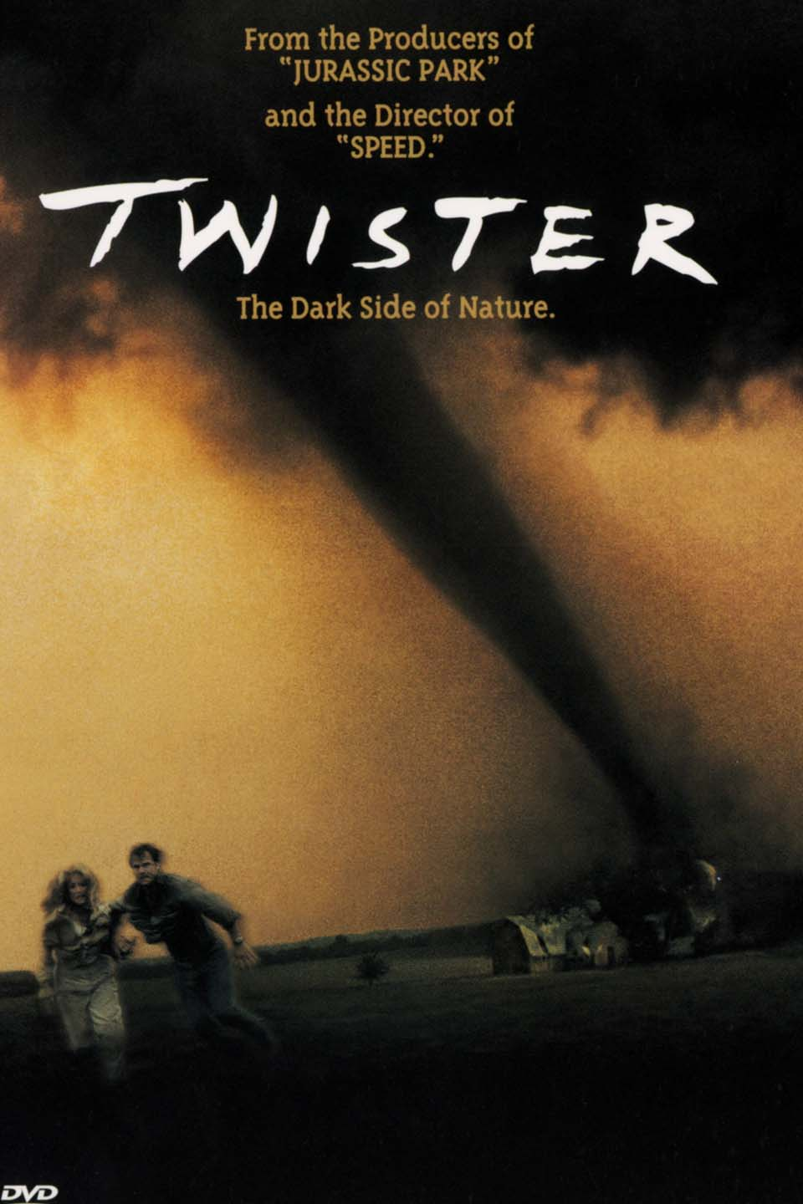
Tornadoes
Miles Winston
Tyler Bade
Notes:
When adding visualizations, title should describe the visualization and the content should be the picture

Slide 2
Purpose
Problem
Tornadoes are unpredictable and destructive, and in many cases, unstoppable. While it is know how and why they form, and how bad they can be, there is still some uncertainty as to how we can counter these disasters and save both money and lives.
The purpose of us choosing this data science project was to map the occurrence of tornadoes in the United States and come up with solutions that could better protect against them and help governments and companies better understand the risks behind them.

Slide 3

Method
Data source: NOAA Weather data
Original:
1950-2017: 1.1GB of data
Issues stemming from performance and not displaying compete data when opened
Revised:
2002-2017: 900MB of data, 22,313 Tornadoes
Given data on state/county, beginning/ending coordinates, F-Scale, beginning/ending date/time
Deaths, Damage numbers (that needed converting)
Notes:
Tyler: Tools we used are
Tableau
Web (Research)
Python
Excel

Slide 4
What we know
Caused by a convergence of cold and warm air creating rotation
Can reach close to 300 MPH and can travel many miles (average distance travelled = 12.41 km or 7.71 mi, found using Haversine formula with our data)
Moves northeasterly (Data gives us an average slope = 0.5598)
Notes:
Tyler: For anything we know about tornadoes already, or find out that should belong here.
For slope, it suggests that it either goes Northeast or Southwest, and tornadoes move with the weather (easterly). Every mile east, it goes .5598 mi north.

Slide 5
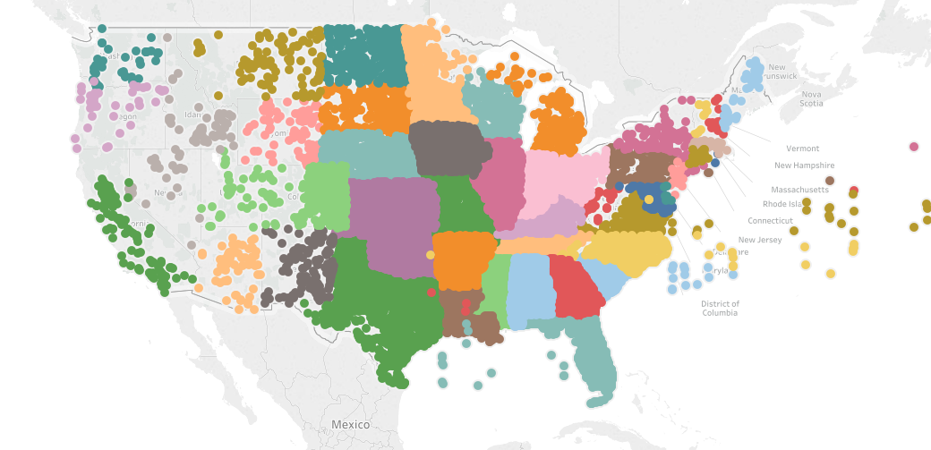
All tornadoes (Map view, colored by state) 22,313 Tornadoes since 2002 - 2017
Notes:
Miles

Slide 6
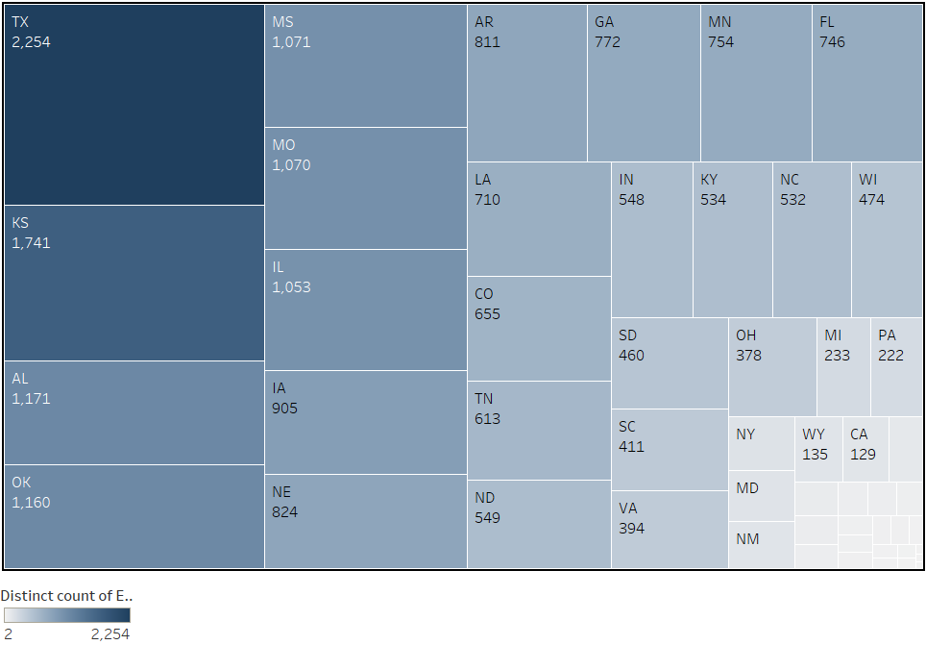
Tornadoes Per state
Notes:
Tyler: Here you will see that Texas leads the states for the most tornadoes. Minnesota (our state) leads 12th for the most tornadoes in the country. Keep Alabama in mind because that state will be our biggest focus point.

Slide 7
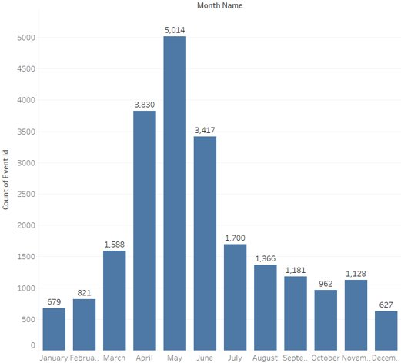
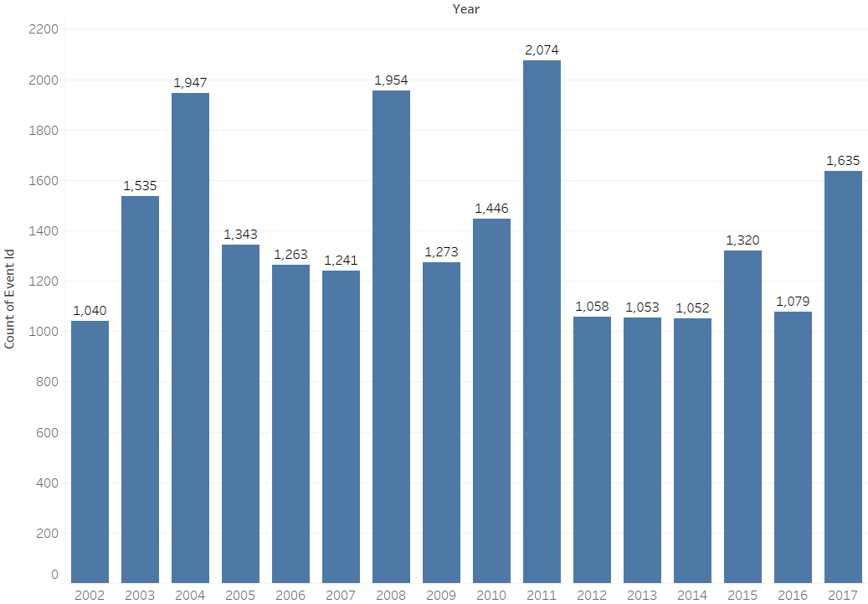
Tornado counts
Per Month
Per Year
Notes:
Tornadoes happen the most in May.
2011 Was a record year for tornadoes in the data we used. A super outbreak on April 27th of 770 tornadoes happened in a 11 hour period, including 11 EF4 and 4 EF5 tornadoes.

Slide 8
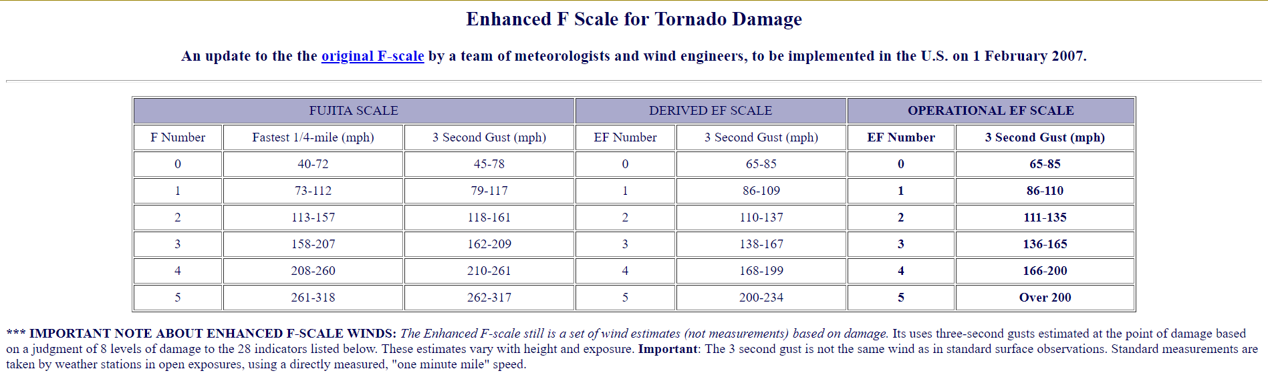
Fujita scale (F-scale and EF-scale)
Source: http://www.spc.noaa.gov/faq/tornado/ef-scale.html
NOAA's page on tornado EF-scales
Notes:
Revised in 2007 to have lower windspeed values for damage since they realized damage could be done at a lower windspeed.

Slide 9
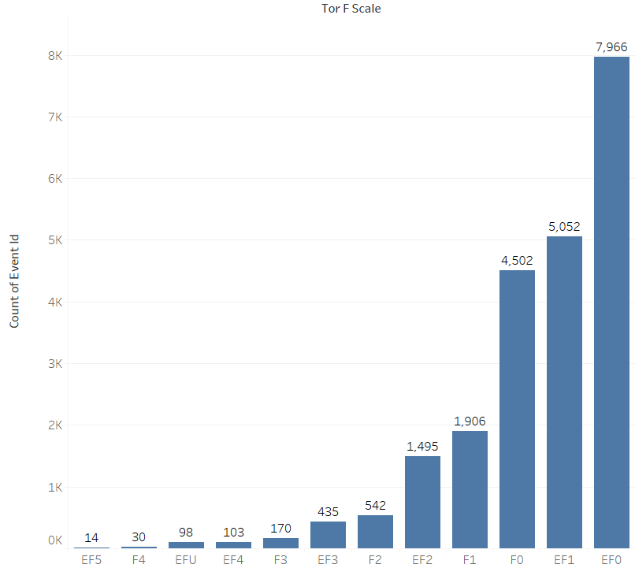
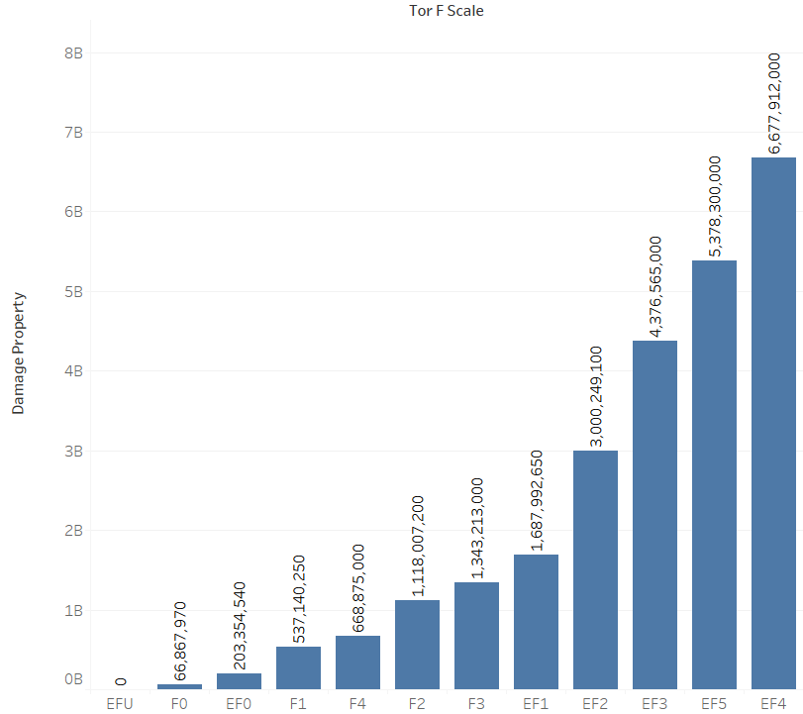
Chart of F readings
Count of
Damage from
Notes:
EFU tornadoes occur when there is not enough data (damage or windspeed wise) to give a tornado a classification.

Slide 10
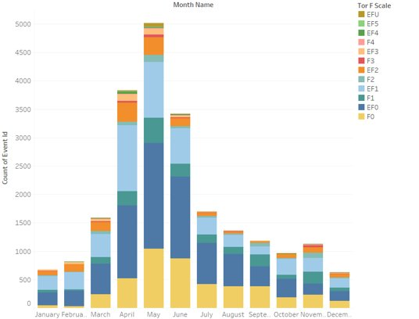
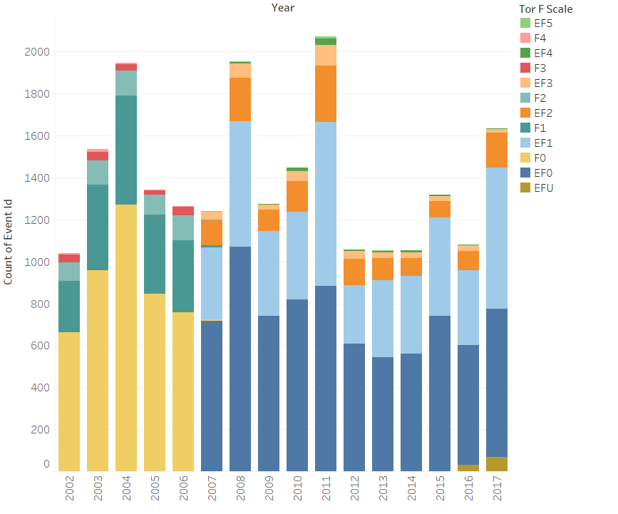
Tornadoes 2002-17 (by F/EF Category)
Per Month
Per Year

Slide 11
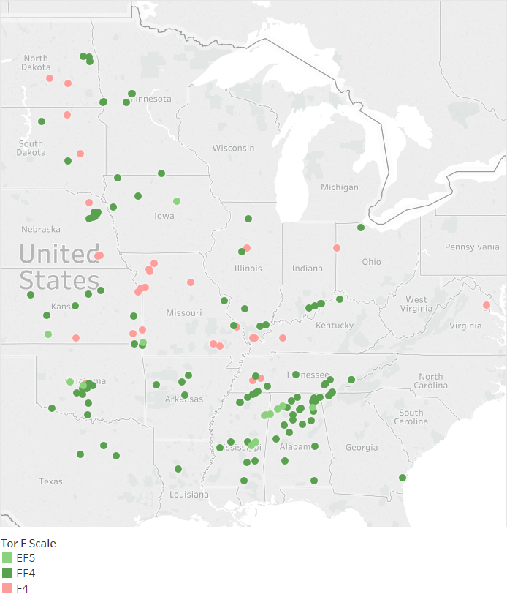
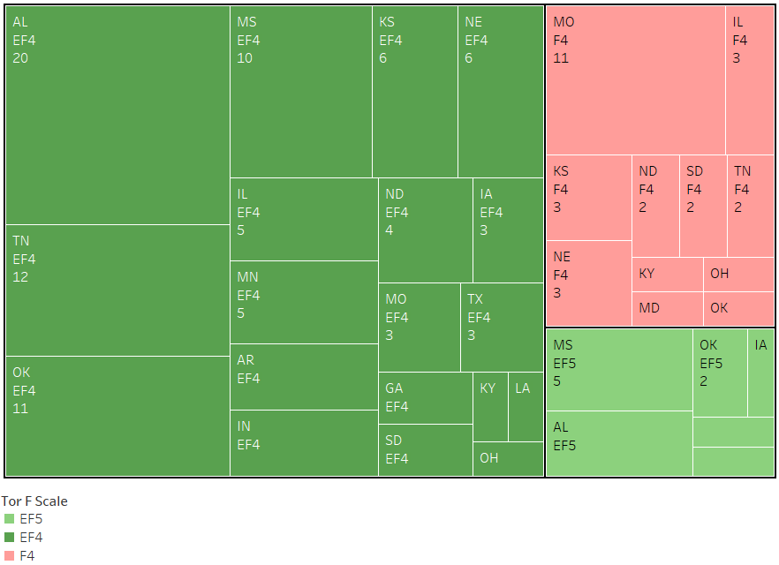
F4 and higher tornadoes
Notes:
Here you will see where EF4, F4 and EF5 tornadoes have occurred. You will notice that Alabama has had a lot of severe tornadoes compared to many other states.

Slide 12
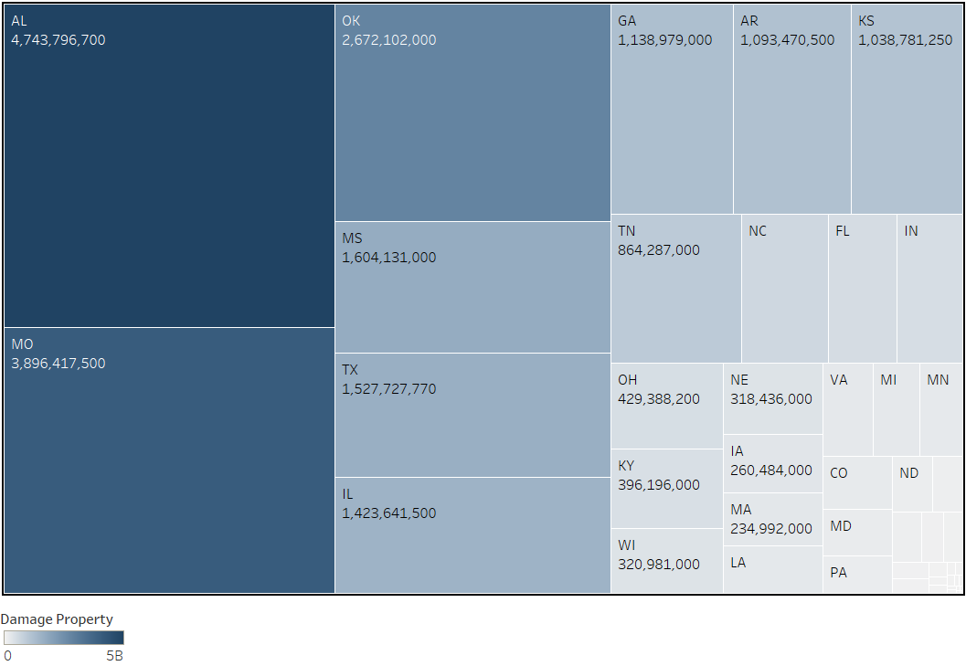
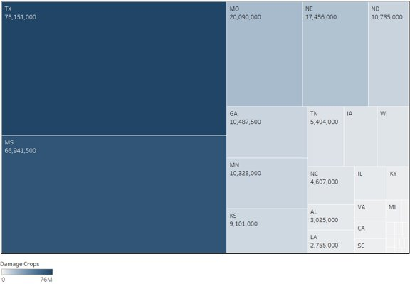
Tornado Damage
Property
Crop
Notes:
Alabama leads for the most tornado damage. We choose Alabama as our biggest focus point because of how big of an outlier it is for damage. You saw that Texas has near twice the amount of tornadoes at 2254 compared to Alabama's 1171.

Slide 13
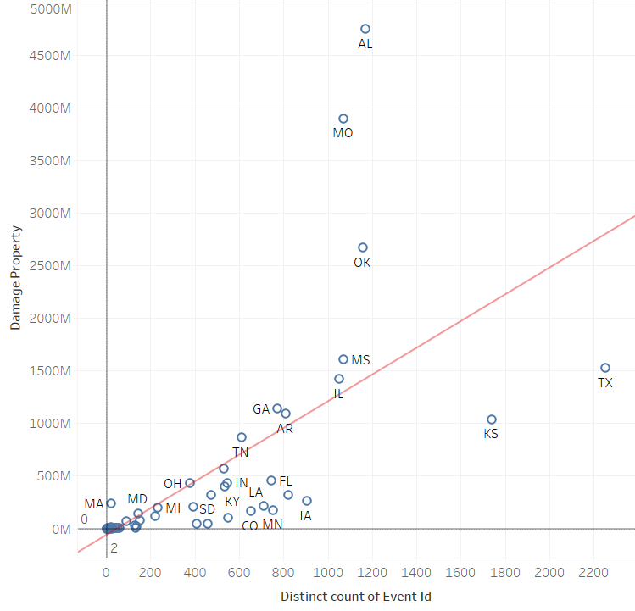
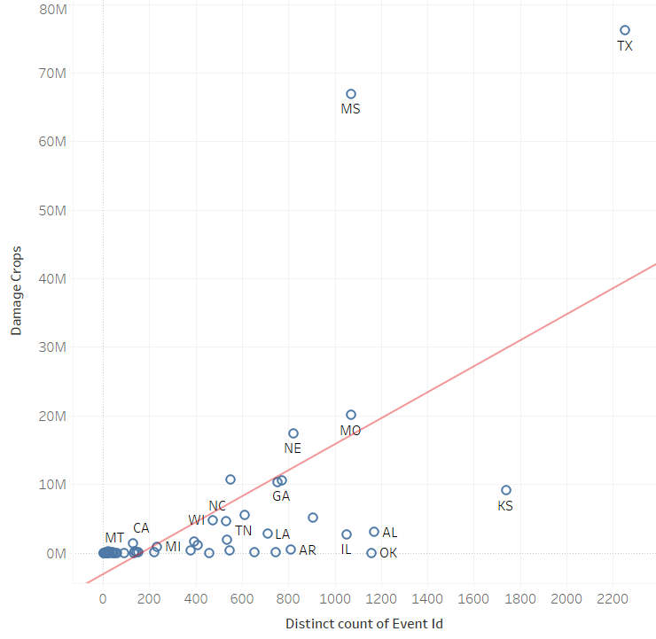
Total Property damage to tornadoes comparison R² = .43
Tornado Crop damage to tornadoes comparison R² = 0.426

Slide 14
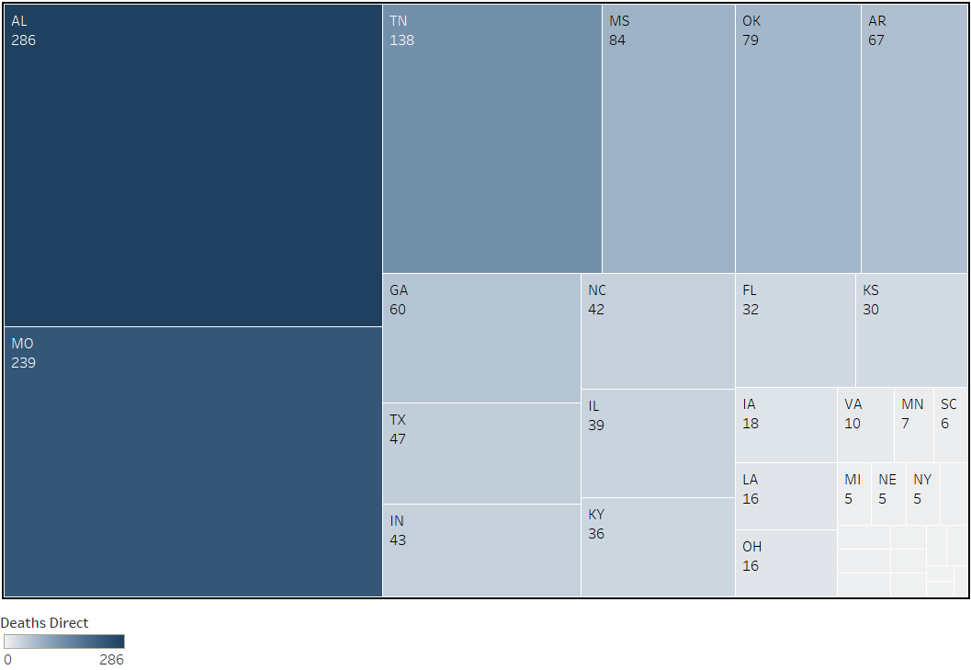
Deaths per state
Notes:
Once again Alabama leads in our chart here with the number of deaths, most likely because of the correlation with damage.

Slide 15
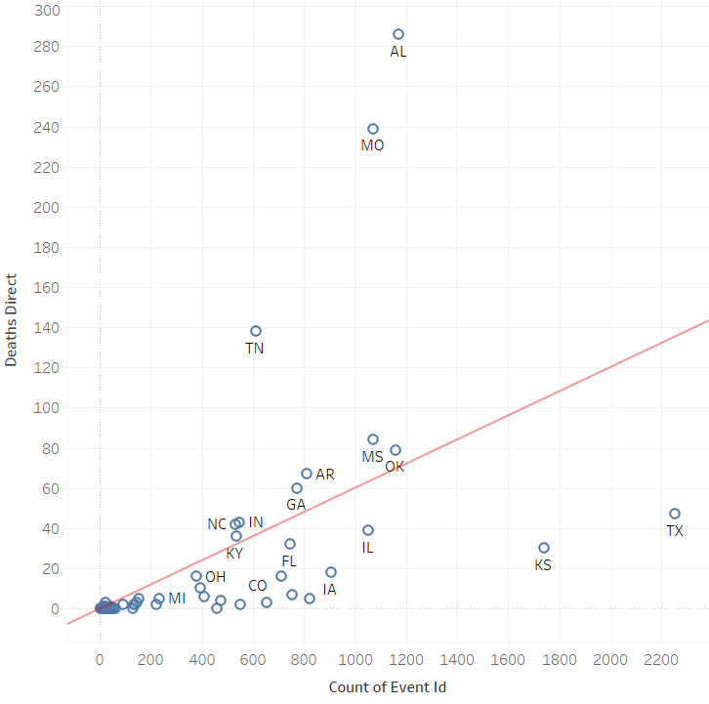
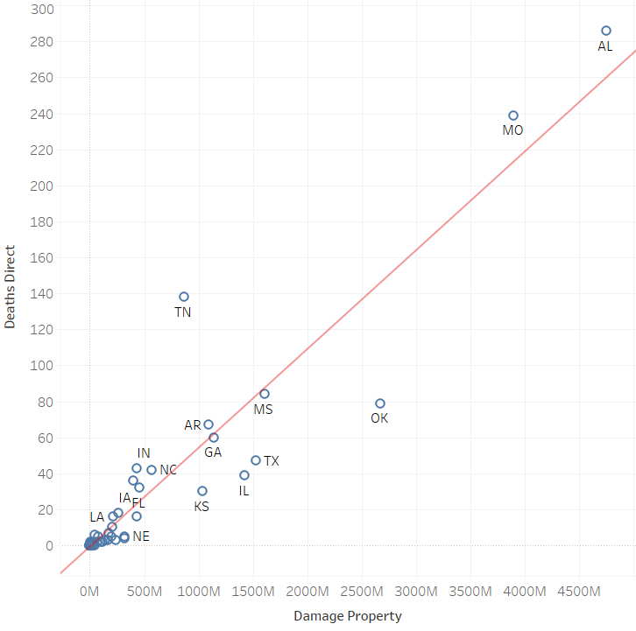
Deaths to tornado count R² = .28
Property Damage to Deaths (by state) R² =0.877791

Slide 16
How would this data help?
Knowing where building code is weak can help us understand where it needs to improve.
Insurance companies would like to know the highest risk areas.
Researchers need to know where to allocate their resources and any patterns associated with tornadoes are important.
Governments can better allocate disaster relief funds related to tornadoes, and can fund better disaster awareness in these areas.
Notes:
Miles

Slide 17
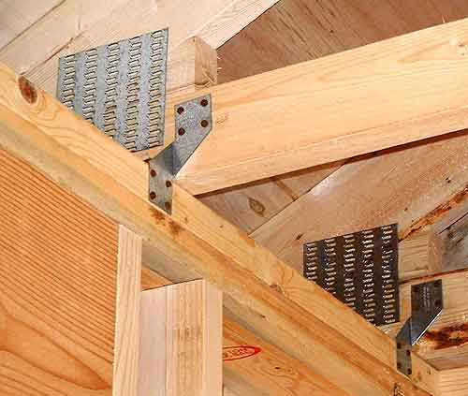
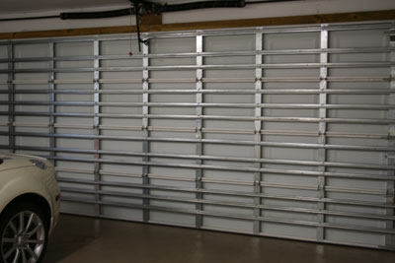
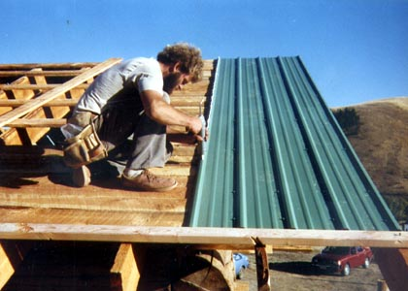
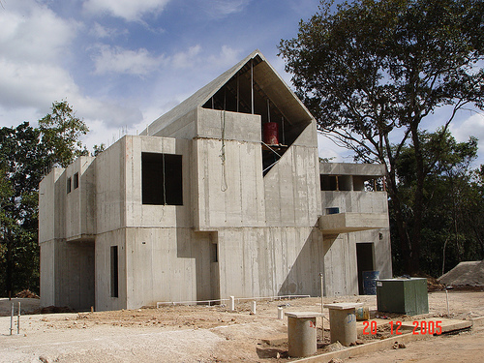
Suggestions
Better building codes
Stronger roof sheathing
Hurricane clips
Wind-Resistant garage doors
Reinforced concrete shells (IFC)
Better Federal and State laws dealing with building codes
FEMA aid to those seeking help on upgrading their homes or building storm shelters.

Slide 18
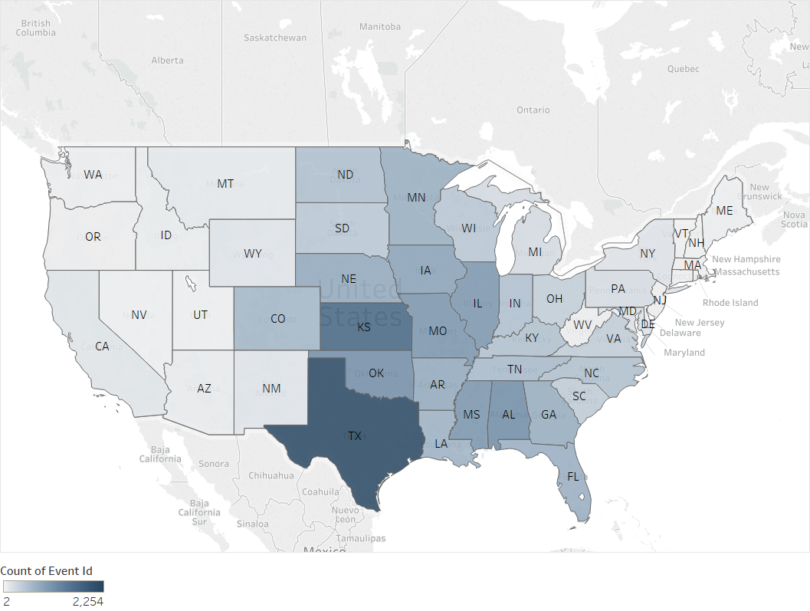
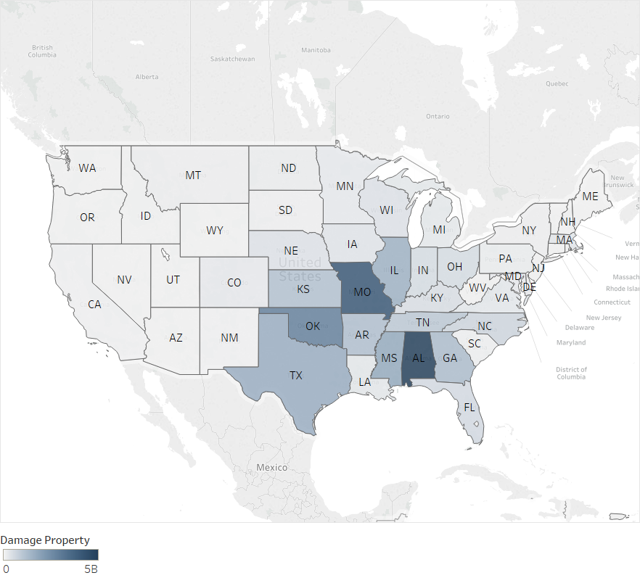
High risk areas
Number of Tornadoes
Damage From Tornadoes

Slide 19
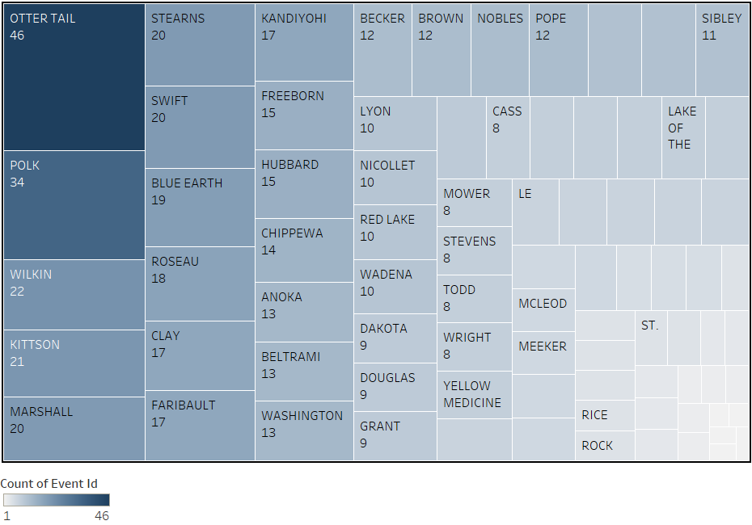
Minnesota Tornado Count (by county)
Notes:
Tyler: Here we will look at our own state and see what counties get the most tornadoes. The western half of Minnesota seems to get more tornadoes.

Slide 20
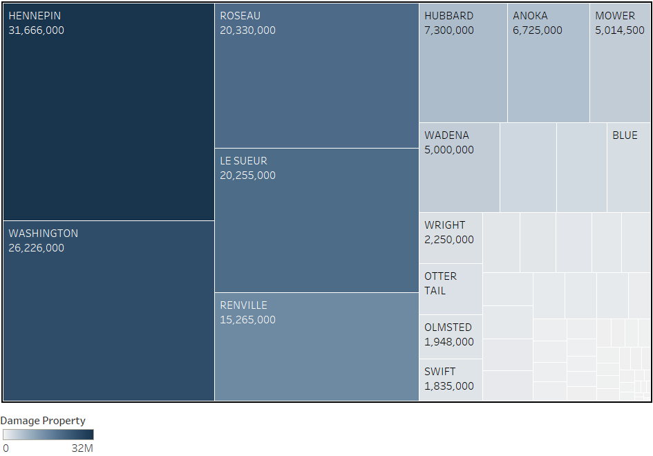
Minnesota tornado damage (by county)
Notes:
Hennepin and Washington surround Ramsey county, damage outside those is spread around the state (Roseau up north, Le Sueur South, Renville west)

Slide 21
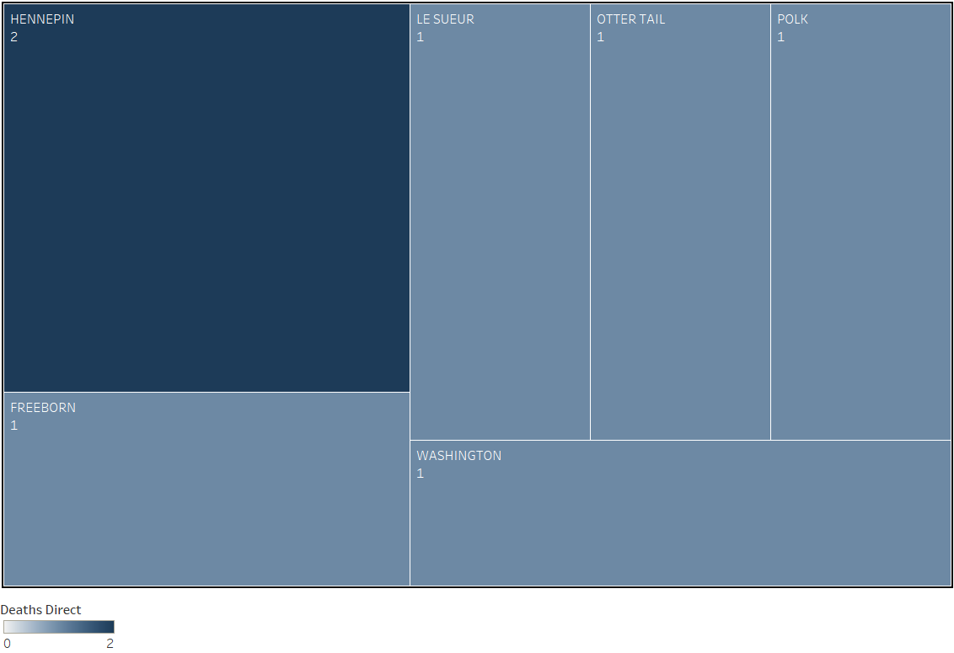
Minnesota tornado deaths (by county)
Notes:
Minnesota has a very low count of direct tornado deaths comared to Alabama.

Slide 22
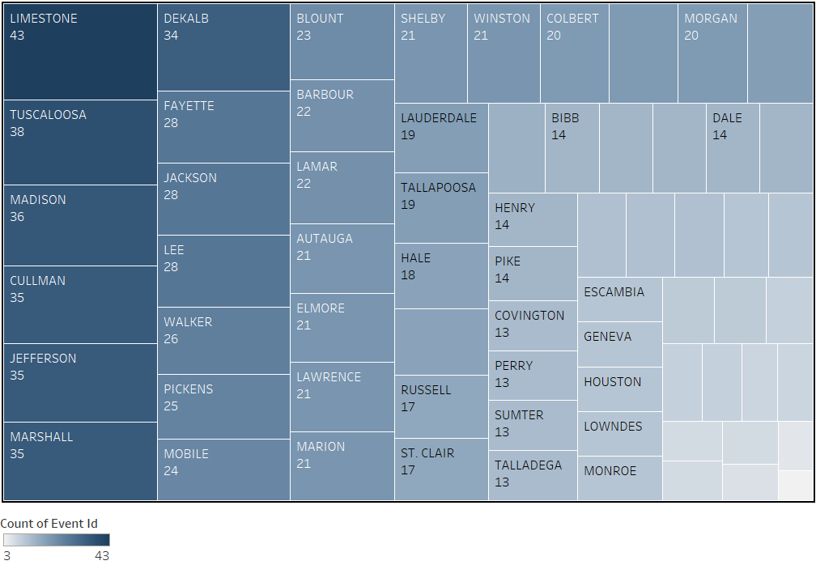
Alabama Tornado Count

Slide 23
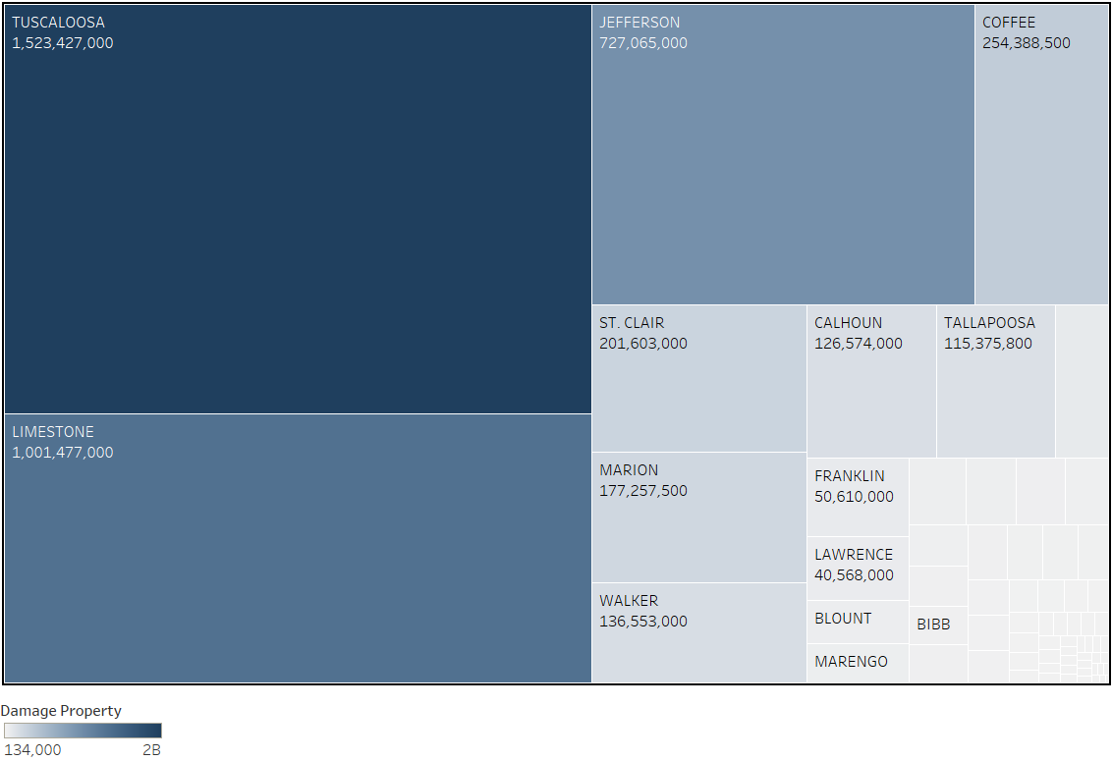
Alabama tornado damage (by county)
Notes:
Tuscaloosa and Jefferson are two high population areas right next to each other, and account for 47% of all damage in Alabama, with Limestone (which is further north), those three counties account for 68% of damage in the state

Slide 24
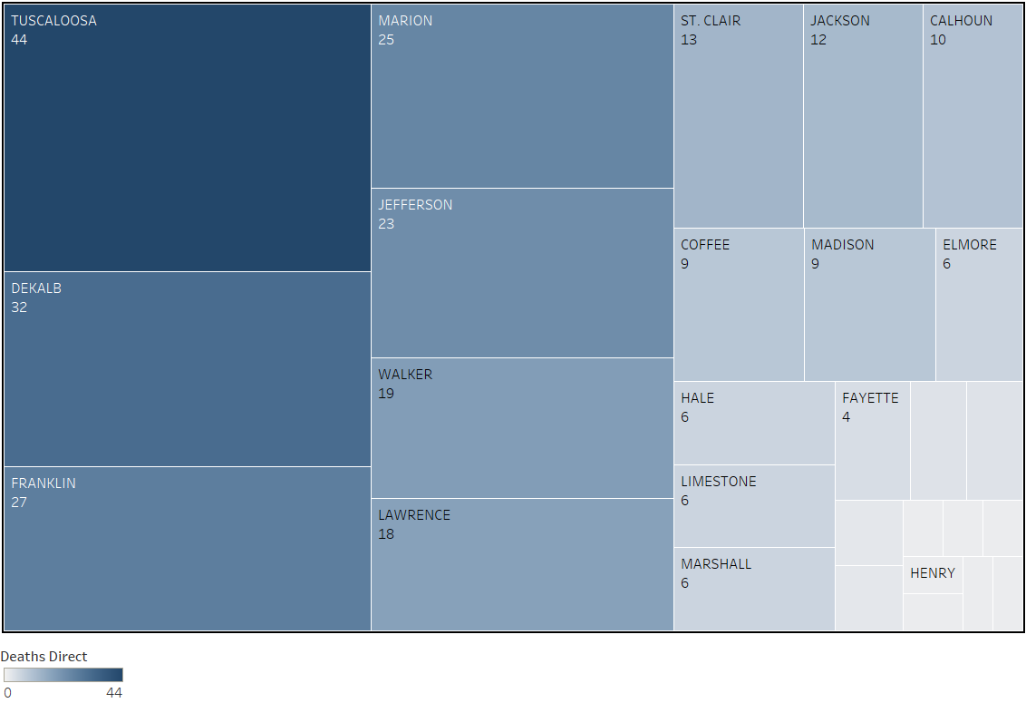
Alabama Tornado Deaths (by county)
Notes:
Tuscaloosa remains high up on there, but other counties have overtaken the other two high damage counties, limestone barely charts.

Slide 25
Other Facts
From our data
Top 3 Damage: Jasper, MO ($2.8B), Cleveland, OK ($2.3B) Tuscaloosa, AL ($1.5B)
Top 3 Deaths: Jasper, MO (161), Tuscaloosa, AL (44), Dekalb, AL (32)
Deadliest and costliest Tornado: Joplin Tornado, May 22, 2011 (158, $2.8B)
Overall
Deadliest: Tri-state tornado, March 18, 1925 (695)
Costliest: Joplin tornado, May 22, 2011 ($2.8B)
Notes:
All deadlier tornadoes happened before NOAA began recording data (1950), these stats are from our data, all tornadoes deadlier than that happened before 1947, earlier than NOAA data collection began

Slide 26
Sources
Council eyes changes to river, tornado-zone building codes http://www.tuscaloosanews.com/news/20180211/council-eyes-changes-to-river-tornado-zone-building -codes Reducing Tornado Damage with Building Codes 2014 http://www.air-worldwide.com/Blog/Reducing-Tornado-Damage-with-Building-Codes/ Tornado Survival Could Improve with better building Codes 2014 https://www.scientificamerican.com/article/tornado-survival-could-improve-with-better-building-codes/ Is Climate Change to Blame? 2016 http://blogs.ei.columbia.edu/2016/12/01/increasing-tornado-outbreaks-is-climate-change-responsible/ Tornado intensity article (Fujita/enhanced Fujita used) https://en.wikipedia.org/wiki/Tornado_intensity IBHS ranking building code in hurricane area https://disastersafety.org/ibhs-news-releases/new-ibhs-report-rates-building-codes-18-coastal-states/ NOAA Fujita Scale http://www.spc.noaa.gov/faq/tornado/ef-scale.html Main data source NOAA ftp.ncdc.noaa.gov/pub/data/swdi/stormevents/csvfiles/ Tornado records https://en.wikipedia.org/wiki/Tornado_records
http://www.air-worldwide.com/Blog/Reducing-Tornado-Damage-with-Building-Codes/ http://disastersafehomes.com/put-together.php http://www.natureworldnews.com/articles/18697/20151210/new-building-codes-aim-protect-u-s-devastating-tornadoes.htm https://journals.ametsoc.org/doi/full/10.1175/WCAS-D-14-00032.1

